Slide 1


Multimedia System on Chip
Jan. 22, 2021
Coherent Plane-Wave Compounding using Delay-and-Sum Beamforming for Ultrasound B-mode Imaging on PYNQ
Presenter: Yi-Lin Lo, Chen-Chien Kao, Yu-Chi Lee
Graduate Institute of Electronics Engineering, National Taiwan University
Github: https://github.com/aqle4090/MSOC_FINAL_DAS

Slide 2
Introduction to B-mode Imaging
B(brightness)-mode image: A two-dimensional ultrasound image for tissue structure
Application: Fetus, Echocardiography, Carotid artery, etc.

Slide 3
Ultrasound Beamforming
Ultrasound Beamforming: Sum the echoes which backscatter from the same position
Delay = Transmit delay + Receive delay
Transmit delay: Firing wave transmits to scan pixels
Receive delay: Backscatter signals of scan pixels to transducer elements

Slide 4
Plane-wave Beamforming: Delay Calculation
25 degrees are adopted in this work
Degree 0
Degree α
[1] G. Montaldo, et al., IEEE Trans. UFFC, 2009

Slide 5
Receive Apodization (F-number Control)
In ultrasound system, the lateral resolution is not small enough compared to the axial resolution (sampling frequency)
The lateral resolution is directly proportional to the F-number (F) [2]
Receive apodization helps maintain a constant resolution over imaging depth [3]
D: Imaging Depth
A: Aperture Size
F: D/A
[2] Z. Alomari, et al., Proc. IEEE Int. Ultrason. Symp., 2015
[3] M. Yang, et al., Proc. IEEE Int. Ultrason. Symp., 2014

Slide 6
Coherent Plane-Wave Compounding
By assuming that the transmit beam is steered in M different angles and back scattered waveforms are received on an N-element linear array, after appropriate delays for the specific pixel, a 2-D matrix X of MxN is given by
x_{ij} is the signal received on channel j after a transmitted excitation at firing angle i
By averaging all of these matrix elements, we obtain the compounded data as
[4] N. Q. Nguyen, et al., IEEE Trans. UFFC, 2018

Slide 7
Image Partition in Processing
A ultrasound B-mode image consists of 8 block images, and each of the block image are compounded by 25 block images with different firing angles
A block image with one angle can be constructed from a set of echo with pixel-wise beamforming
Echo Buffer
1792 x 32
32 channels
Block image with one angle
224 depth samples
Angle 0
Angle 1
Angle 24
16 beamlines

Slide 8
Flow Chart
Real Part
Imagine Part

Slide 9
Challenge: Computational Complexity
The computational complexity of delay calculator is the highest in this design
Lots of loop operations Needs to be optimized
The total process implemented by CPU takes too much time (18s)
Target: 1sec for one B-mode image

Slide 10
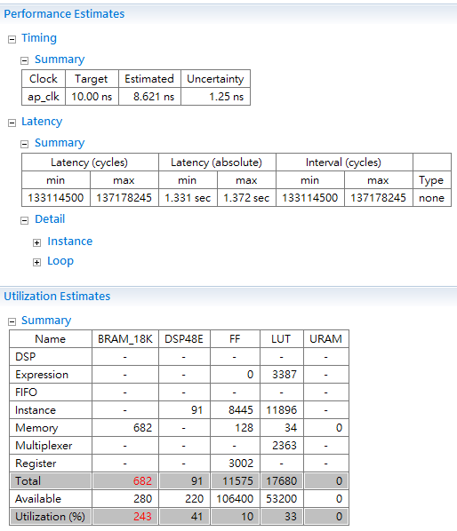
Baseline Design
*All codes of this work is developed by ourselves
Baseline Version:
Multiple angles of input data for one block are stored
Output is only ready after all blocks are computed
→ Needs lots of BRAM for saving input/output
No #pragma in the code

Slide 11

Optimization 1-1: Data Access
In this work, a total of 200 pages (8 blocks, each block are compounded using 25 angles) of echo data is collected to construct a B-mode image
A page of echo is streaming in the DAS kernel for one kernel computation (200 times)
A block image is streaming out when a block compounding is completed (8 times)
199
7
1
1
0
0
Input a page of echo
(200 times)
Output a block image
(8 times)
DAS
Kernel
Echo 0
1792 x 32
Block 0
224 x 16
Intermediate are stored by static variables

Slide 12




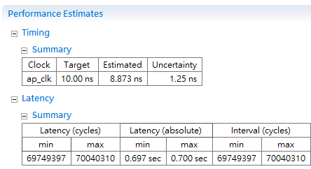
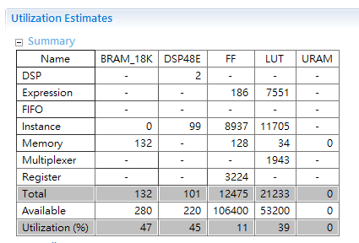
Optimization 1-2: Fixed Point Conversion and Down-sampling
Since lots of BRAM are needed for input data and output data with floating point
Reduce the BRAM usage and save input and output data with fixed point is necessary
Fixed Point Conversion
Down-sampling
1792 224
Origin
BRAM Utilization
243 %
47 %

Slide 13
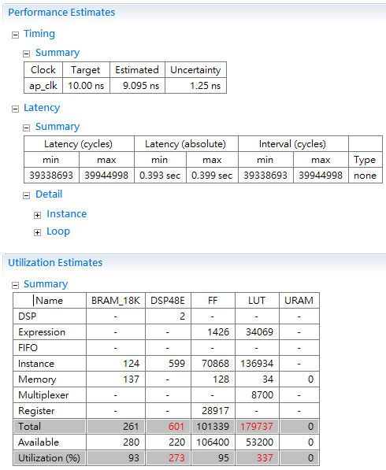
Optimization 2: Parallel Delay Computing
#pragma HLS UNROLL
*Hard to reduce the usage of DSP48E and LUT

Slide 14

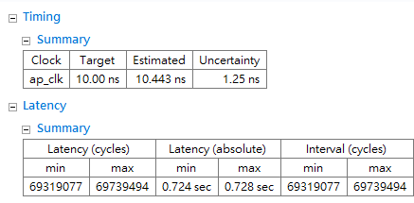
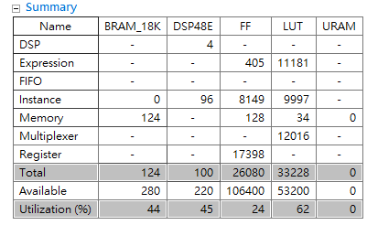
Optimization 3: Change Constant Floating Point to Fixed Point Multiplication
BRAM Utilization
47 %
44 %

Slide 15
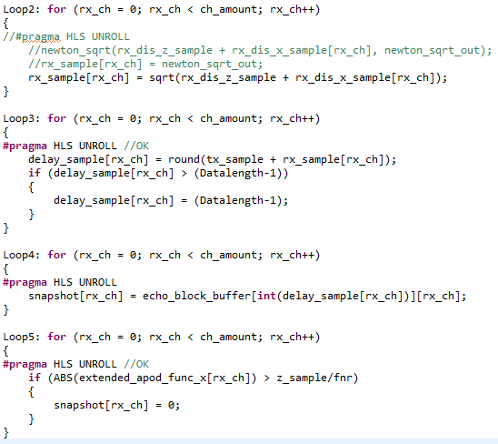
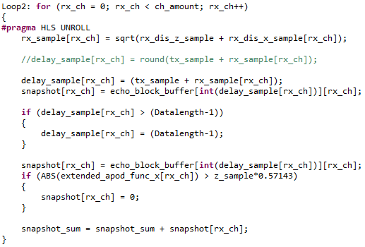
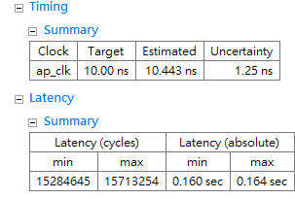
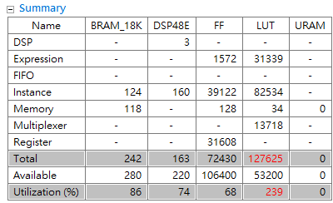
Optimization 4: Merge Loop
Integrate several loop operations in a single loop
Latency
0.724
0.160

Slide 16
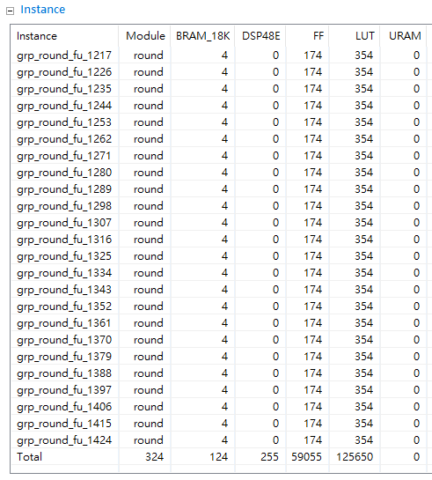
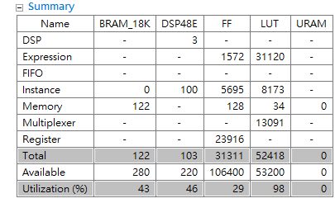
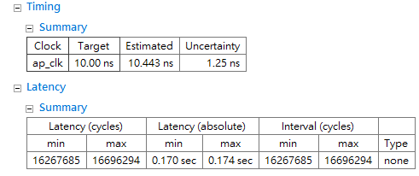
Optimization 5: Remove Round Operation
Round operation needs lots of LUT
Round operation needs lots of LUT !!!
LUT
Utilization
239 %
98 %

Slide 17
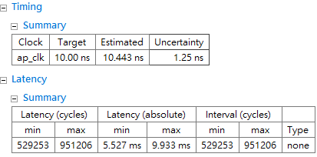
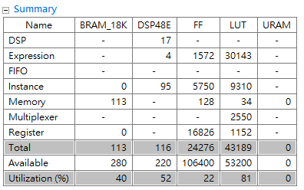
Optimization 6: IIR Pipelining
In the previous design, a total beamline data with 1792 samples is passed directly into function IIR
To adopt the pipelining technique, a single data is passed into the function IIR once the data is ready from previous step
Intermediate parameters in the filter are stored by static variables
#pragma HLS PIPELINE
Latency
170 ms
5.527 ms

Slide 18
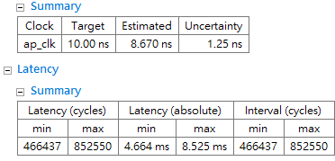


Optimization 7: Critical Path Breaking
There exists some critical paths in function IIR
Break the long equation into several equations
Real Part
Imagine Part
Timing
10.443 s
8.670 s

Slide 19
Interface of Input/Output Streaming
Two input and one output ports in original interface
Using AXI Stream with 2 DMA (1 in, 1 out) for data streaming
(similar as lab 2)

Slide 20


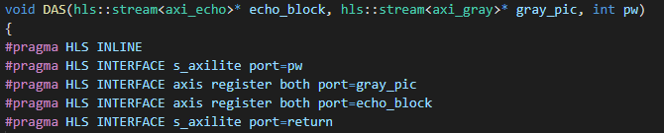
Interface Implementation
Types for input and output streaming
Connect to fixed-point input/ output in the kernel
Top of the kernel design

Slide 21


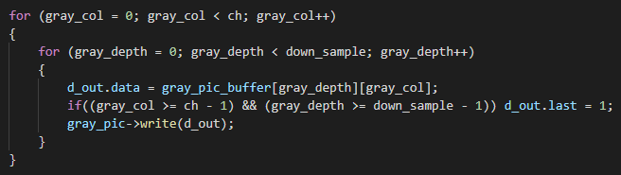
Header File <ap_axi_sdata.h>
Use the header file <ap_axi_sdata.h> for AXI streaming interface
Contain 7 member
The signal “last” is required for stream implementation
Control the data length

Slide 22
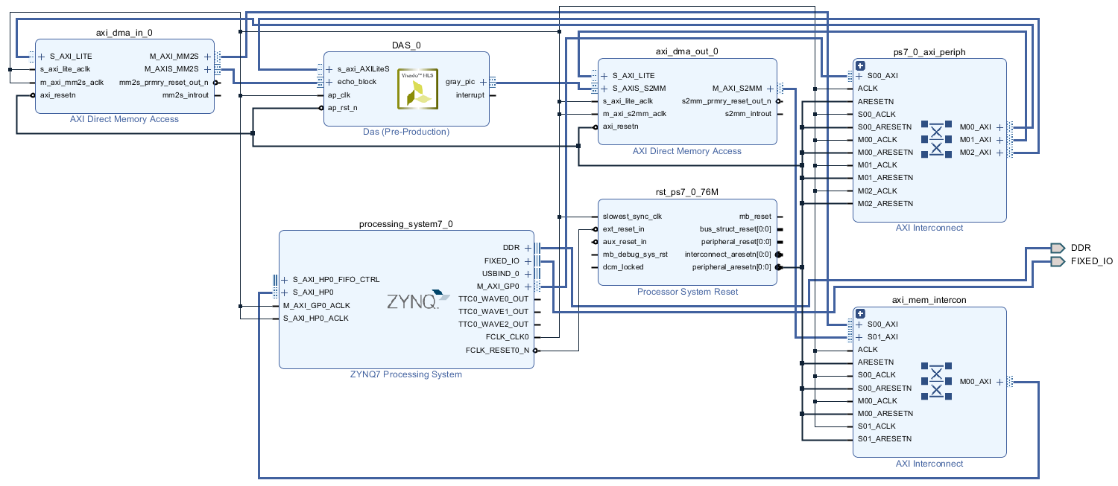
Block Diagram
Platform: Zedboard

Slide 23
Block Diagram
Two DMA for data streaming
Input: echo
Output: gray image
Host
Control peripheral
Plot Result
Kernel
Beamforming
32bit
32bit

Slide 24
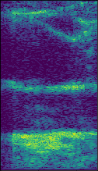
Demo Result
Scheduling
Final Result
→ 10.6x faster compared to CPU

Slide 25
Thanks for your attention
Q & A

